Slide 1
Blind system identification (BSI) Date：2022. 01. 17
Telecom Electroacoustics Audio(TEA) Lab
Presenter:
Anchi Yuan
Notes:
Hello everyone
I’m today’s presenter siang. I’m going to share some of my present work in source separation problem. My topic is comparative studies of source separation using semi-blind and blind source separation approaches.

Slide 2
Outline
CTF based Eigenvalue decomposition algorithm (CTFEDA)
Short RIR
Simulation setting
Simulation results
Long RIR
Simulation setting
Simulation results

Slide 3
CTFEDA

Slide 4
Short RIR
Simulation setting
Simulation results

Slide 5
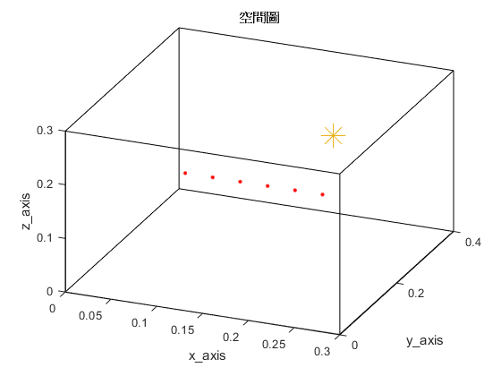
Simulation setting
Six microphones uniform linear array (ULA)
Sampling frequency = 16kHz
Reverberation time T₆₀ = 0.009s (9ms)
Ground-truth RIR samples = 256
Room dimension = 0.3m x 0.4m x 0.3m
Microphone spacing = 0.02m
Source type: white noise
source
(0.2, 0.3, 0.2)
H = 0.3m
y
mic
(0.1, 0.1, 0.2)
z
x
W = 0.4m
L = 0.3m

Slide 6
Simulation results

Slide 7
Long RIR
Simulation setting
Simulation results

Slide 8
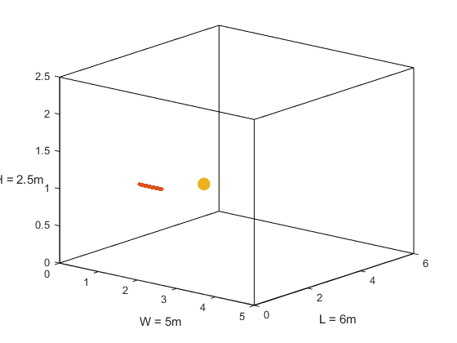
Simulation setting
Thirty microphones uniform linear array (ULA)
Sampling frequency = 16kHz
Reverberation time T₆₀ = 0.4s (400ms)
Ground-truth RIR samples = 8192
Room dimension = 5m x 6m x 2.5m
Microphone spacing = 0.02m
Source type: white noise
First mic (1, 1.5, 1)
Source (2, 2.6, 1)
mic spacing = 0.02m
z
y
x

Slide 9
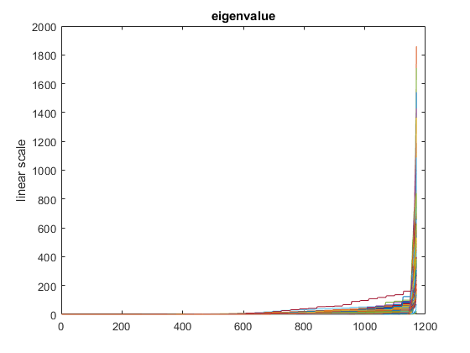
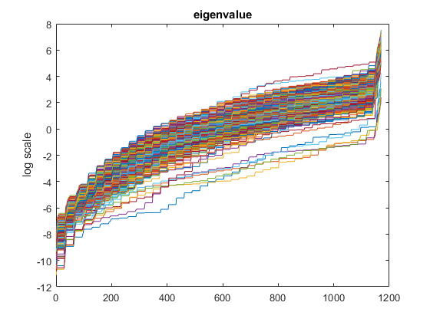
Simulation results

Slide 10


© anchi_0203

